Slide 1
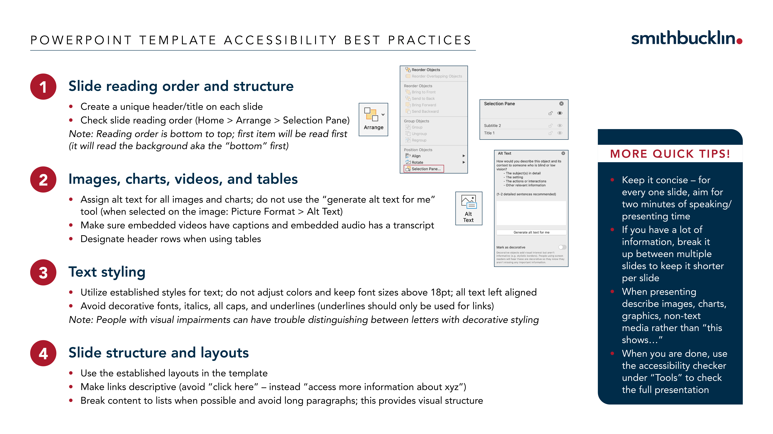

Slide 2
Presentation title can go on these lines here
Subtitle or other information can go on these lines

Slide 3
Slide title goes on this line here
Bullet one
  Bullet two
    Bullet three
      Bullet four
        Bullet five
Bullet one
  Bullet two
    Bullet three
      Bullet four
        Bullet five

Slide 4
Slide title goes on this line here
Bullet one
  Bullet two
    Bullet three
      Bullet four
        Bullet five
Bullet one
  Bullet two
    Bullet three
      Bullet four
        Bullet five
Bullet one
  Bullet two
    Bullet three
      Bullet four
        Bullet five
Bullet one
  Bullet two
    Bullet three
      Bullet four
        Bullet five

Slide 5
Section divider title can go on these lines

